Slide 1
Welcome right to vote

Slide 2
E-Voting System
Under the guidance of:
E. Santosh Mali(Java Trainer)
Enrollment Number | Name of the Student
EBEON0721406149 | Vishnu.M

Slide 3
E-Voting System
Contents:
Introduction
Technical Spefications
Modules
Advantages
Conclusion

Slide 4
Technical specification:
HTML
CSS
JavaScript
Core Java
IDE:
Eclipse

Slide 5
INTRODUCTION:
In this project we will see about casting our votes through online without going to the polling stations.
E-Voting System helps people who cannot be physically available at polling stations.
This system ensures only one vote per person i.e., no duplicate votes can be casted.
It eliminates physical contact with people during the pandemic situation.

Slide 6
Modules:
Home
Registration
Visitor
Admin
Party Description
Password reset

Slide 7
Home:
Homepage will be visible for all the people who visit the website.
It contains general information and awareness content.
Homepage contains necessary modules for the users to vote and use the website.

Slide 8
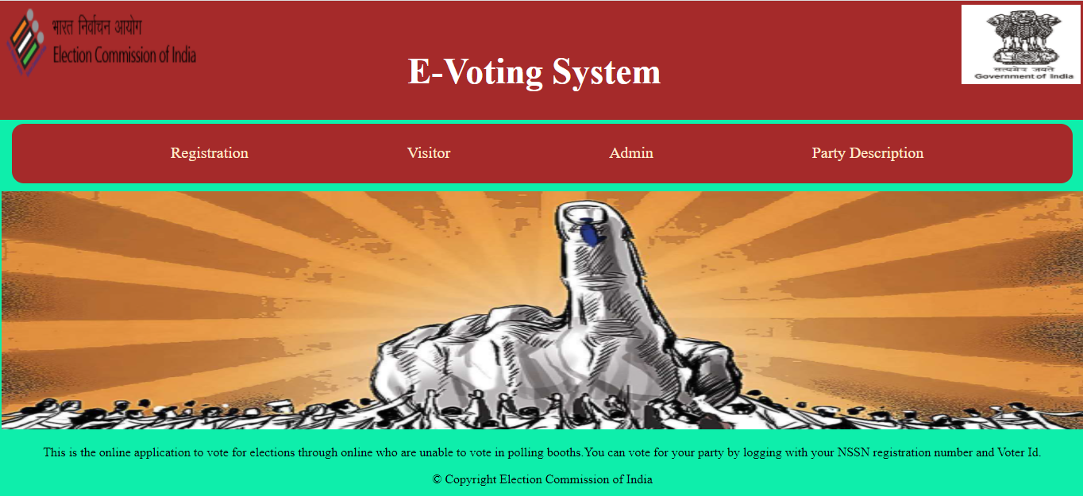
Homepage:

Slide 9
Registration:
Registration page is where new users can register themselves.
This can be done using email-id , Mobile number and One Time Password(OTP) received to their mobile.
Account is safe and secure as it is password protected.

Slide 10
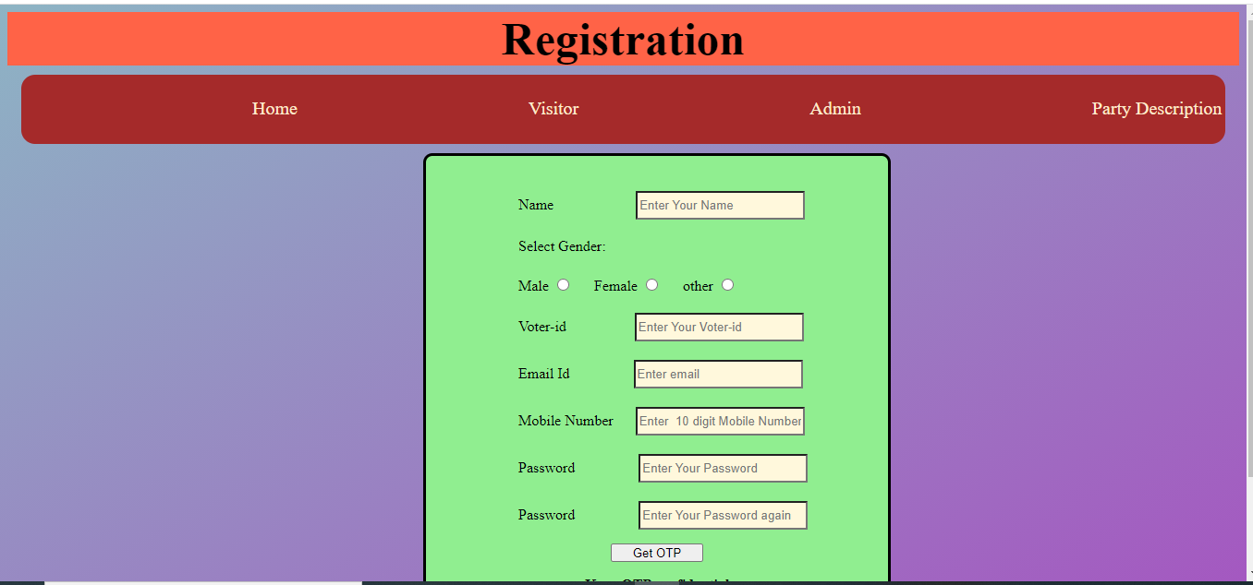
Registration page:

Slide 11
Visitor:
Visitors or public will login here using their registered email id , mobile number and password.
Forgot password can be retrieved by clicking on forgot password option., It will send an OTP to reset your password.

Slide 12
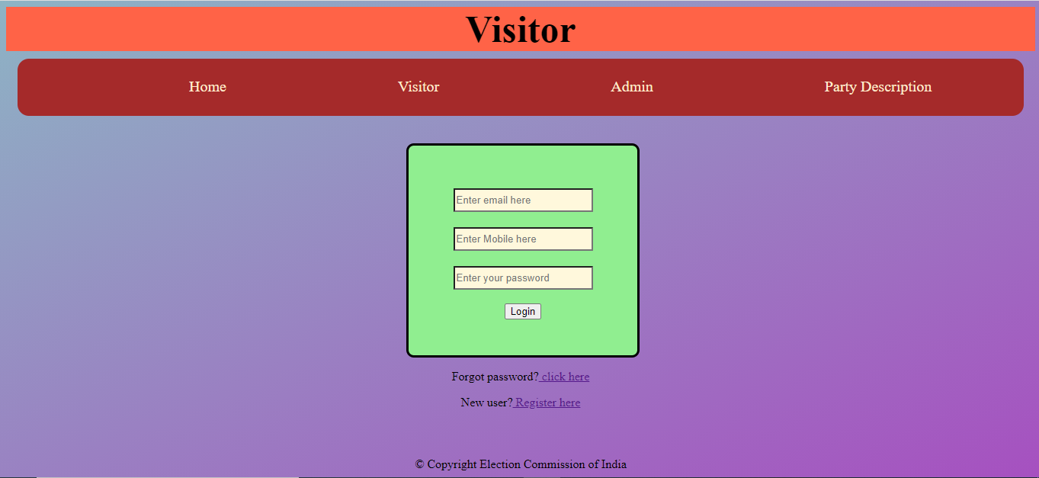
Visitor page:

Slide 13
Admin:
Administrators will login using their registered id and password.
Password is retrieved with the help of forgot password option.

Slide 14

Admin page:

Slide 15
Party Description:
Party description module provides the list of available political parties for users to choose from.
Parties will be changed according to the type of election going on., As of now Nationalised parties are listed.

Slide 16
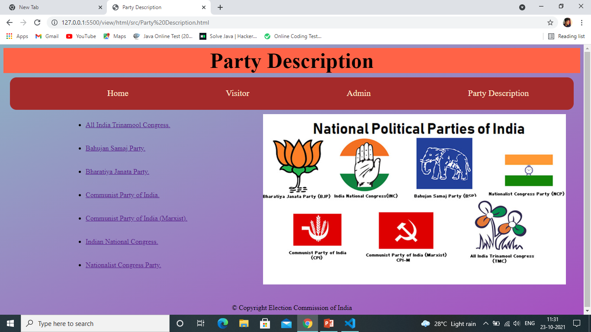
Party Description page:

Slide 17
Advantages:
People can cast their vote through this website during this global pandemic at home.
Easier than casting votes in polling booths.
Can be done from anywhere and anytime.
Saves time and money.
Safe and secure.
Environment friendly as no paper is used.

Slide 18
Conclusion:
As a conclusion we can cast our votes through online at ease from our home.
Eliminates duplicate votes as one vote per user-id.
Saves environment as no paper is involved.
Expenses is reduced for government since no infrastructure is used.

Slide 19
Thank you

